Slide 1
Jackson Adders
Prof. David Money Harris
Matthew Keeter, Andrew Macrae,
Tynan McAuley, Becky Glick, Madeleine Ong
21 December 2010

Slide 2
Overview
Definitions
Tree Adders
Ling Adders
Jackson Adders
18-bit Jackson Tree
Evaluation Methodology
Preliminary Results

Slide 3
Addition
Carry Propagate Adder
  Inputs: A_{N:0}, B_{N:1}
    A₀ = C_{in}
  Outputs: S_{N:1}
    Discard C_{out}

Slide 4
Propagate, Generate, Kill
Oh My!
Bitwise Signals
  Generate: G_{i:i} = G_{i} ≡ A_{i}B_{i}
  Propagate: P_{i:i} = P_{i} ≡ A_{i}+B_{i} Also called ~K_{i}
  X_{i} ≡ A_{i} xor B_{i}
Group Recursion to form prefixes
  Propagate P_{i:j} = P_{i:k}P_{k-1:j}
  Generate G_{i:j} = G_{i:k}+P_{i:k}G_{k-1:j}
  Group generates if upper part generates or upper part propagates and the lower part generates
Bitwise Sum
  S_{i} = X_{i} xor G_{i-1:0}

Slide 5
Higher Valency Groups
Valency-2
  Propagate P_{i:j} = P_{i:k}P_{k-1:j}
  Generate G_{i:j} = G_{i:k}+P_{i:k}G_{k-1:j}
Valency-3
  Propagate P_{i:j} = P_{i:k}P_{k-1:l}P_{l-1:j}
  Generate G_{i:j} = G_{i:k}+P_{i:k} (G_{k-1:j}+P_{k-1:I}G_{l-1:j})
Valency-4
  Propagate P_{i:j} = P_{i:k}P_{k-1:l}P_{l-1:m}P_{m-1:j}
  Generate G_{i:j} = G_{i:k}+P_{i:k}(G_{k-1:j}+P_{k-1:I}(G_{l-1:m}+P_{l-1:m}G_{m-1:j}))

Slide 6
Tree Adders
How should the recursion be organized?

Slide 7
Black and Gray Cells
Black cell:
  Group G and P
Gray cell:
  Group G only
Inverting vs. non
Higher Valency

Slide 8
Tree Adders

Slide 9
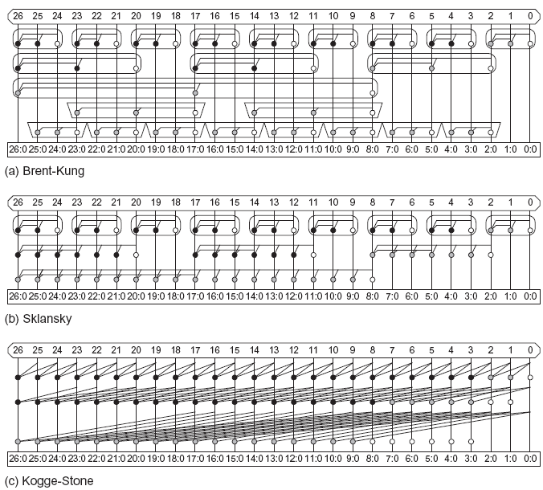
Higher Valency Trees

Slide 10
Sparse Trees
Sklansky sparseness 4
  Only compute prefixes for every 4th column
  Precompute 4-bit results for each possible carry in
  Select result based on carry (group generate)

Slide 11
Carry Selection

Slide 12
Ling Adders
Factor some complexity out of first term
Insert it back into sum selection
Remove 1 transistor from critical path
Exploits fact that G_{i}P_{i} = (A_{i}B_{i})(A_{i}+B_{i}) = G_{i}

Slide 13
Ling Equations
Define Pseudogenerate: H_{i:j} ≡ G_{i} + G_{i-1:j}
  Simpler than G_{i:j} = G_{i} + P_{i}G_{i-1:j}
  Recreate G_{i:j} = P_{i}H_{i:j} = P_{i}(G_{i} + G_{i-1:j}) = G_{i} + P_{i}G_{i-1:j}
Define Pseudopropagate I_{i:j} ≡ P_{i-1:j-1}
  Shifted version of group propagate
Valency-2 recursion is same as PG
  H_{i:j} = H_{i:k} + I_{i:k}H_{k-1:j}
  I_{i:j} = I_{i:k}I_{k-1:j}
Sum: S_{i} = X_{i} xor G_{i-1:0} = X_{i} xor (P_{i-1}H_{i-1:0})
  Selection mux: S_{i} = H_{i-1:0} ? [X_{i} xor P_{i-1}] : X_{i}
Sum selection mux chooses S_{i} based on late-arriving H_{i-1:j}

Slide 14
Ling Circuits
Simplifies first stage
Compute H_{i+1:I} in one swell foop
Easy
Too hard

Slide 15
Jackson Adders
Generalized Ling technique
  Simplify logic in the prefix tree as well
  Use sum selection to reinsert missing terms
  Balance logic so both data and select to sum mux are comparable in criticality
Developed by Jackson and Talwar in 2004
  Used in Arithmetica synthesis tool
  Parameterized by architecture, valency, sparseness
  Reportedly produced superior energy-delay tradeoffs
  Burgess09 indicates benefits over standard designs
  No comprehensible complete published designs

Slide 16
Jackson Logic
Define new terms
D: a group generates or propagates a carry
  Special case:
B: a group generates a carry in at least one bit
Rewrite group generate:
  Group generates if upper part generates or propagates and either at least one bit of upper part generates or the low part generates

Slide 17
Reduced Generate
Again,
Rename bracketed term reduced generate R
  R^{p} is like G with the top p prop. signals stripped out
  R⁰_{i:j} = G_{i:j}
  R¹_{i:j} = H_{i:j}
  Jackson considers p ≥ 2
Group generate can be rewritten in terms of R
  Computing R prefixes can be easier than G

Slide 18
Hyperpropagate
Another term will be useful for recursion: hyperpropagate
Define
  Special case for 2-bit groups:

Slide 19
Jackson Recursions
Valency-2 is no simpler
Valency-3 simplifies R at expense of Q
Compare with
Compare with

Slide 20
Valency-3 Circuits
Compound gate implementation
Simpler gate implementation

Slide 21
Logical Effort of Valency-3
 | PG | RQ Compound | RQ Simpler
G_{generate} | 4 | 2.67 | 2.22
G_{propagate} | 1.67 | 3.33 | 2.77
P_{generate} | 5 | 4.33 | 4
P_{propagate} | 4 | 4.66 | 4

Slide 22
Sum Selection
Select sum based on R^{p}_{i-1:0}
  Requires p-bit D signal for sum-selection data input
    This is the complexity that is factored out of R
D recursion

Slide 23
Prior Work
[Jackson04]
  + Introduced R and Q
  + Showed how to compute a single sum output
  Does not show how to build an entire adder
  Does not include recursions for D, valency-2 R/Q
[Burgess09]
+ Comments on critical path
+ Comparisons suggest benefits of Jackson adder
- Hard to decipher diagram of 24-bit adder

Slide 24
Example
18-bit Jackson Adder
  Sklansky tree with sparseness 2
  Valency-2 initial stage (like Ling)
  Valency-3 2nd and 3rd stages
  Only 4 levels of noninverting logic

Slide 25
Initial Stage
Reduced Generate
Hyperpropagate
Also will need g_{i} for even bits, p_{i} for odd bits, x_{i} for all bits
  For sum selection logic

Slide 26
Second Stage
Compute 3 and 6-bit group signals
  Note potential for sharing common terms

Slide 27
Third Stage
Reduced generate signals for all groups

Slide 28
D Logic
Medium-length groups of D are required for sum selection
Note that D_{17:9} depends on R³_{17:12}
  Hence, arrives at same time as R⁹_{17:0}

Slide 29
Sum Selection
Sparseness of 2 requires 1-bit ripple from even to odd

Slide 30
Prefix Network

Slide 31
Comparison Methodology
Goal: energy-delay curves for Jackson adders compared to conventional adders
How can we objectively compare against the best conventional design?
  Technology mapping challenges
  Sizing
    Gatesizer limitations
    SCOT is better, but we only have 130 nm models
  Inadequate design effort on conventional cases
Plan: synthesize with Design Compiler
  Compare against assign y = a + b;

Slide 32
Cell Library
IBM 45 nm partially-depleted SOI 12S ARM Library
  sc12_base_v31_rvt_soi12s0_ss_nominal_max_0p90v_125c_mxs.lib
  A12TR library with regular V_{t} (RVT) transistors
  12 track cell height (1.68 μm)
  Typical operating point: 1.0 V, 25 C
  We use worst-case slow-slow, 0.9 V, 125 C library
    Use Maxsol (mxs) version for worst-case history effect
  1X inverter INV_X1B_A12TR:
    Width = 0.38 μm
    C_{in} = 1.6 fF
    FO4 delay = 15 ps
    Switching energy: 0.00078 μW/MHz ≈ 0.8 fJ
      equals 0.5 C_{in}V_{DD}²
    Leakage power: 0.1 μW (very high!)

Slide 33
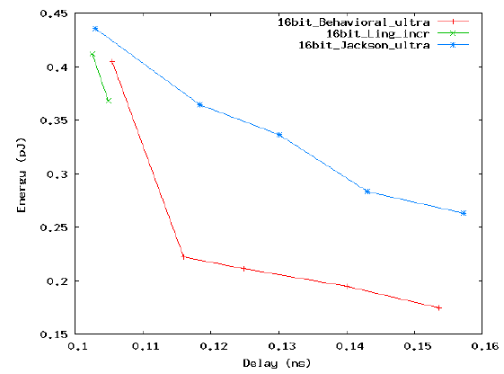
Preliminary Results
Truncated 18-bit Jackson adder slightly outperforms y = a + b at high energy
Ling adder also slightly beneficial
Fastest designs are 105 ps (7 FO4)
Jackson takes more energy except at very long delay

Slide 34
References
[Burgess09] N. Burgess, “Implementation of recursive Ling adders in CMOS VLSI,” Proc. Asilomar Conf. Signals, Systems and Computers, 2009, pp. 1777-1781.
[Jackson04] R. Jackson and S. Talwar, “High speed binary addition,” Proc. Asilomar Conf. Signals, Systems and Computers, 2004, pp. 1350-1353.
[Jackson08] R. Jackson, “Data detection algorithms for perpendicular magnetic recording in the presence of strong media noise,” Ph.D. thesis, Department of Mathematics, University of Warwick, 2008.
[Ling81] H. Ling, "High-speed binary adder," IBM J. Research and Development, vol. 25, no. 3, May 1981, pp. 156-166.
[Patil07] D. Patil, O. Azizi, M. Horowitz, R. Ho, and R. Ananthraman, "Robust energy-efficient adder topologies," Proc. Computer Arithmetic Symp., Jun. 2007, pp. 16-28.
[Weste10] N. Weste and D. Money Harris, CMOS VLSI Design, 4th Ed., Boston: Addison-Wesley, 2010.
[Zlatanovici09] R. Zlatanovici, S. Kao, and B. Nikolic, “Energy-delay optimization of 64-bit carry-lookahead adders with a 240 ps 90 nm CMOS design example,” IEEE J. Solid-State Circuits, vol. 44, no. 2, Feb. 2009, pp. 569-583.

